Slide 1
Perspective
□ Dynamic
□ Static
□Physical
■ Mixed(describe): System context
Node
- Node information for registration
Sensing Data : Temperature/Humidity/Door /Presence(proximity)/Mail Box
<< Display information >>
User Authorization Success / Fail
Node Authorization Success / Fail
Set Rule Success / Fail
Display Log information
- Node information
Legend
IoTMS
: System Element
: Data flow
: User
Log In
Register User
Add, Delete Node
Set Customize rule
Log information
Set Alarm mode (Secure / Unsecure)
Door on/off
- Light on/off
: User action(Event) to IoTMS
Command :
Door on/off, light on/off,
alarm on/off
- Register node
Date: 15-06-20
Architect: Yook Kwon
System Nomenclature: 001
Version: 1.0
Decomposition Level: Level1
Drawing Title: System context

Slide 2
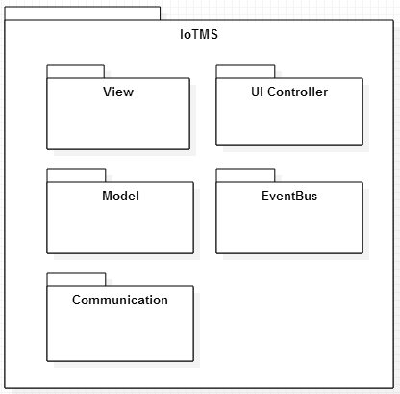
Perspective
□ Dynamic
■ Static
□Physical
□ Mixed(describe):
Static Perspective
Legend
: Package
(Class or Set of Classes)
Date: 15-06-20
Architect: Yook Kwon
System Nomenclature: 002
Version: 1.0
Decomposition Level: Level1
Drawing Title: Static View

Slide 3
Rule manager
Perspective
■Dynamic
□ Static
□Physical
□Mixed(describe):
Rule DB
save rule
scheduler
User
DB
Log
DB
load config
load rules
Config
Rule Set
register
timed action
save
config
Rule Manager
Action
Legend
User Interface Manager
Log
Manager
Message
Manager
A
B
: JSON event , from A to B
Rule Manager Event Receiver
DB
E v e n t B u s
Manager
Thing object
(Sensor, actuator...)
Communication
Manager
Node Manager
Node
Communication module
(Wifi, bluetooth…)
1…*
1…*
Wifi
Node
rule thread object
Node
thread
real world
A
B
real Wifi
Things object List
: information, from A to B
queue
Real SA Node
(Arduino)
actuators
sensors
Default
sensors
actuators
sensors
Default
sensors
Date: 15-06-20
Architect: Yook Kwon
System Nomenclature: 003
Version: 1.0
Decomposition Level: Level1
Drawing Title: Dynamic view

Slide 4

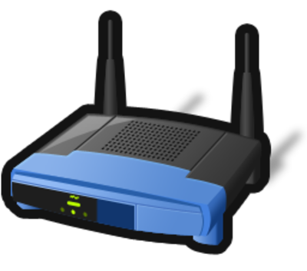


Perspective
□ Dynamic
□ Static
■ Physical
□ Mixed(describe):
Web Browser
http
Legend
IoTMS
IoTMS
Server
Machine
Web Server
(apache-tomcat-8.0.23)
Internet
http
Web Browser
http
Port #8080(User)
Database
(mariadb-10.0.19)
TCP
Port #550
(Arduino)
Data
repository
Windows 7
Sensor
TCP
Port #3250(Discovery)
TCP
Port #3250(Discovery)
first node
second node
User
Machine
arduino-1.0.6
arduino-1.0.6
node
Arduino
node
Door
Door
Mail
box
SW on Machine
Temp.
&Humi.
Alarm
Actuator
Proxi.
Light
Router
Date: 15-06-20
Architect: Yook Kwon
System Nomenclature: 004
Version: 1.0
Decomposition Level: Level1
Drawing Title: Allocation view

